Slide 1

Machine Learning Systems Design
Lecture 6: Evaluation
Reply in Zoom chat:
If you could invite anyone to give a guest lecture in this class, who would that be?
CS 329 | Chip Huyen

Slide 2


Slide 3
Logistics
Notes for lecture 3 & lecture 4 part I out
Assignment 2 out
Join Stanford CS 329S on HuggingFace if you want to use their paid API
Should have received OpenAI API invite by now
Tips for final project
Have P0s, P1s, P2s, etc.

Slide 4
Agenda
Model development & training
AutoML
Model calibration
Debugging
ML system evaluation
Model evaluation

Slide 5
Model development & training

Slide 6
Feedback loop
When model’s predictions influence model’s performance
Model ranks A as most likely to be watched
You put A on top
More people click on A
Model thinks A is good, predicts A even more
Very common with recommendation systems

Slide 7
Feedback loop: solutions
Use positional features (hopefully models will give this feature high weight)
In training, predicting number of views with 1st_position = True for videos shown on top
In production: predicting number of views with 1st_position = False
Calibrate predictions
Mix both most likely + novelty
Limit number of times a sample is shown
Put a threshold on views = 1000, then show it only 50% now

Slide 8
Data parallelism
split the data across devices
each device sees a fraction of the batch
1M samples
1000 samples/batch/machine
1 machine: 1000 batches
100 machines: 10 batches
each device replicates the model
each device replicates the optimizer
GPT-3: 3.2M batch size
Scaling SGD Batch Size to 32K for ImageNet Training (You et al., 2017)

Slide 9
Data parallelism
split the data across devices
each device sees a fraction of the batch
Challenge 1: Learning rate
Too small -> too long to converge
Too large -> unstable learning
each device replicates the model
each device replicates the optimizer
GPT-3: 3.2M batch size
Scaling SGD Batch Size to 32K for ImageNet Training (You et al., 2017)

Slide 10
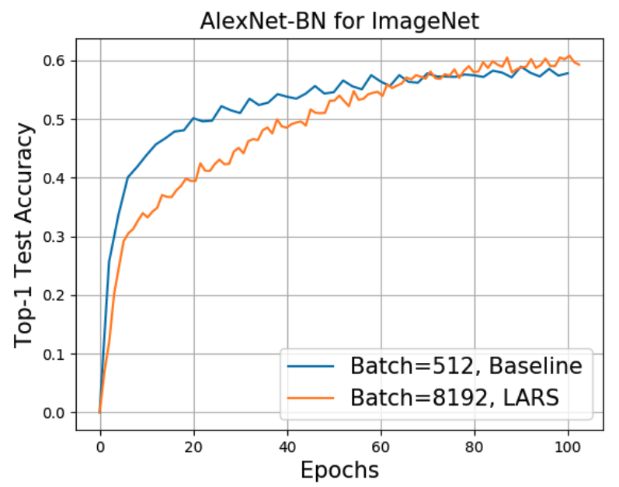
Data parallelism: LR scaling
split the data across devices
each device sees a fraction of the batch
each device replicates the model
each device replicates the optimizer
GPT-3: 3.2M batch size
Scaling SGD Batch Size to 32K for ImageNet Training (You et al., 2017)

Slide 11
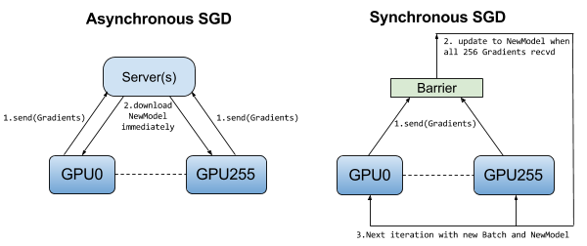
Data parallelism: gradient updates
Challenge 2: How to aggregate gradient updates?
Synchronous: have to wait for stragglers
Asynch: gradients become stale
Image from Distributed TensorFlow (Jim Dowling, O’Reilly 2017)

Slide 12
Model parallelism
Split by:
layers
forward-backward passes
etc.
Challenge: load balancing?
split the model across devices
each device runs a fragment of the model
GPU 1
GPU 2
GPU 3
GPU 4

Slide 13
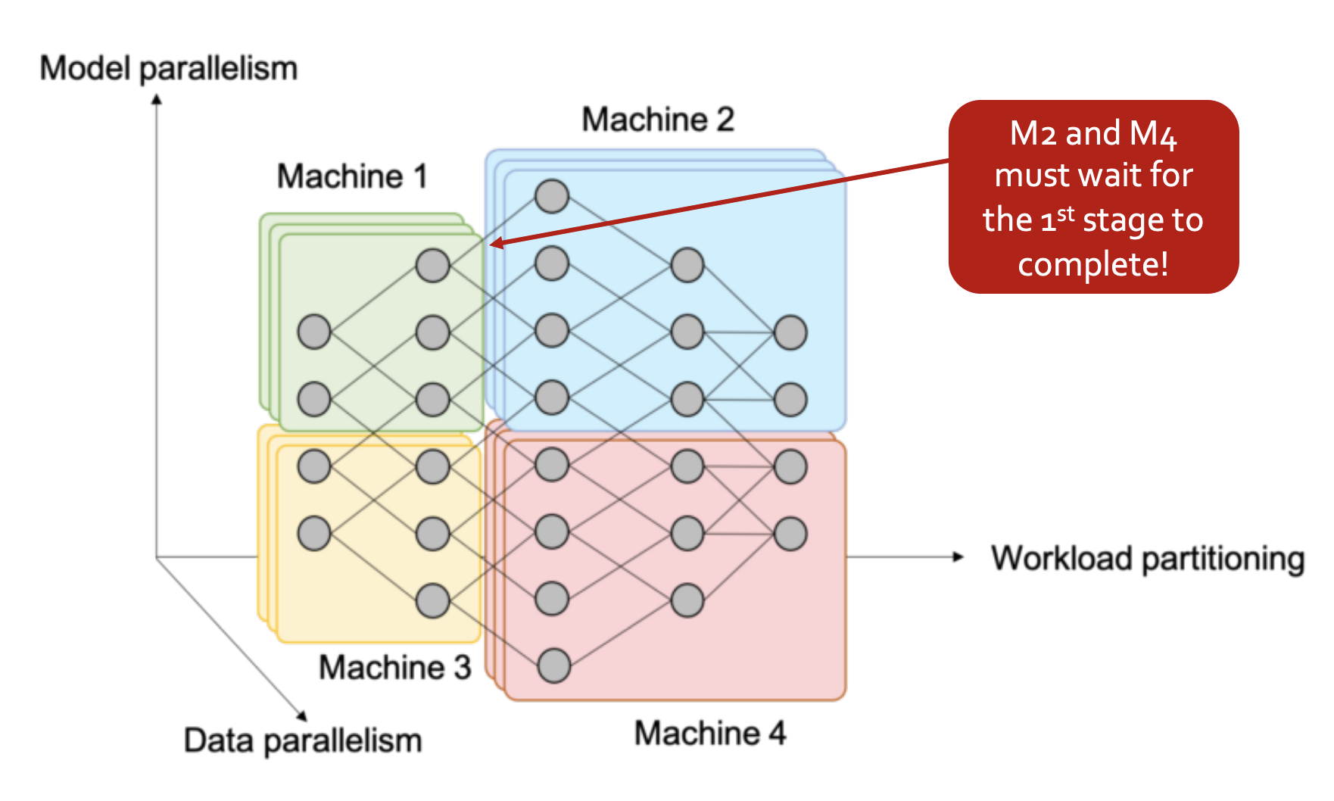
Model parallelism and data parallelism
Mining Massive Datasets course,Stanford, lecture 13. Jure Leskovec 2020.

Slide 14
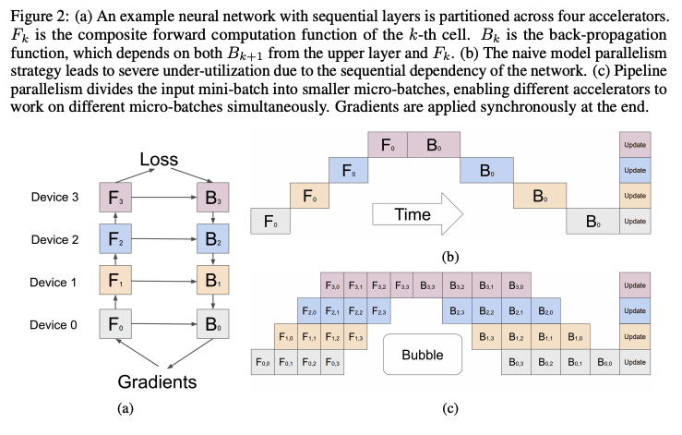
Pipeline parallelism: model + data parallelism
Divide
layers into stages
mini-batches into micro-batches
Spread them across devices
GPipe: Easy Scaling with Micro-Batch Pipeline Parallelism (Huang et al., 2018)

Slide 15
AutoML

Slide 16
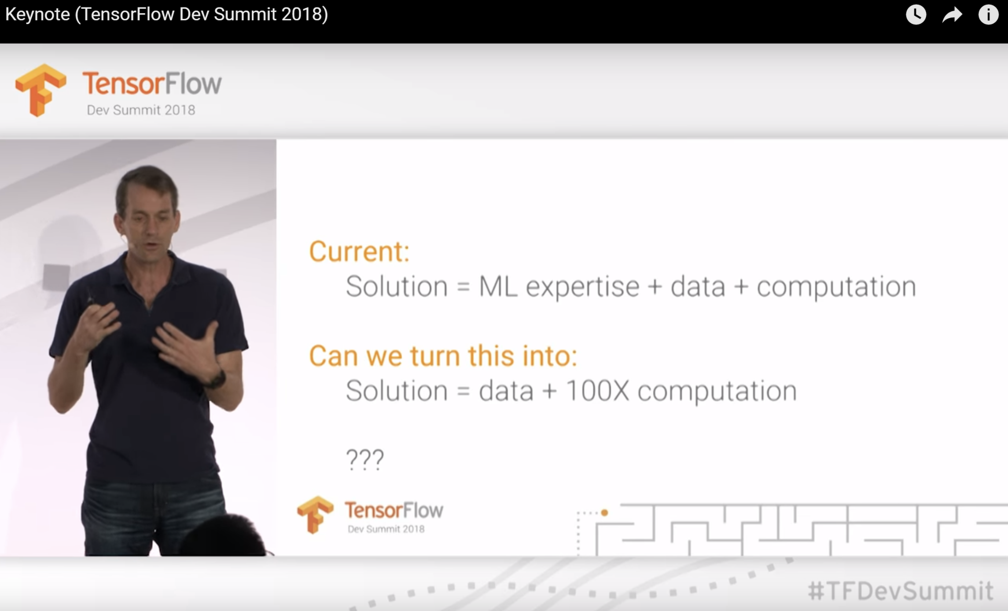
AutoML
A good ML researcher is someone who will automate themselves out of job
Google: what if we replace ML experts with 100x compute?

Slide 17
AutoML
Soft AutoML:
hyperparameter tuning
Hard AutoML
neural architecture search
learned optimizer
More computationally expensive

Slide 18
Soft AutoML: Hyperparameter tuning
Weaker models with well-tuned hyperparameters can outperform stronger, fancier models
On the State of the Art of Evaluation in Neural Language Models (Melis et al. 2018)
Many different hyperparameters:
batch size, learning rate, quantization, number of hidden layers, number of hidden units, dropout probability, etc.
https://twitter.com/GuyZys/status/592847074170896384/photo/1

Slide 19
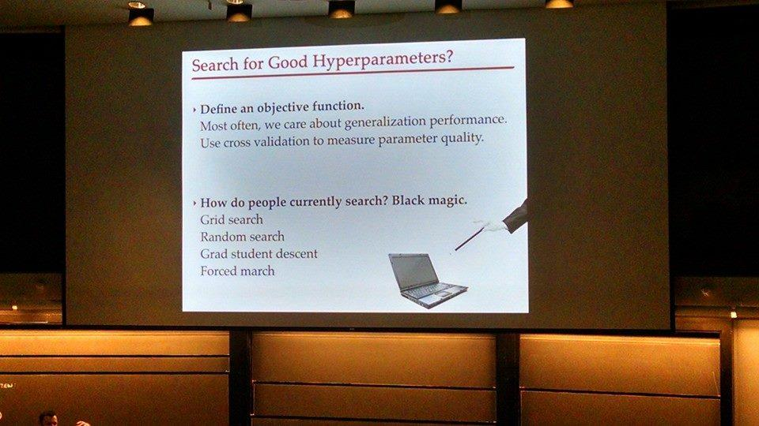
Soft AutoML: Hyperparameter tuning
Graduate Student Descent (GSD):
A graduate student fiddles around with the hyperparameters until the model works
https://twitter.com/GuyZys/status/592847074170896384/photo/1

Slide 20
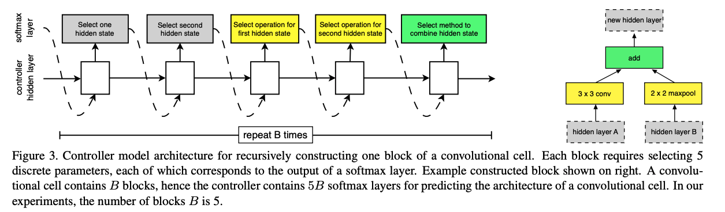
NAS: Neural architecture search
Search space
Set of operations
e.g. convolution, fully-connected, pooling
How operations can be connected
Learning Transferable Architectures for Scalable Image Recognition (Zoph et al., 2017)

Slide 21
NAS: Neural architecture search
Search space
Performance estimation strategy
How to evaluate many candidate architectures?
Ideal: should be done without having to re-construct or re-train them from scratch.

Slide 22
NAS: Neural architecture search
Search space
Performance estimation strategy
Search strategy
Random
Reinforcement learning
reward the choices that improve performance estimation
Evolution
mutate an architecture
choose the best-performing offsprings
so on

Slide 23
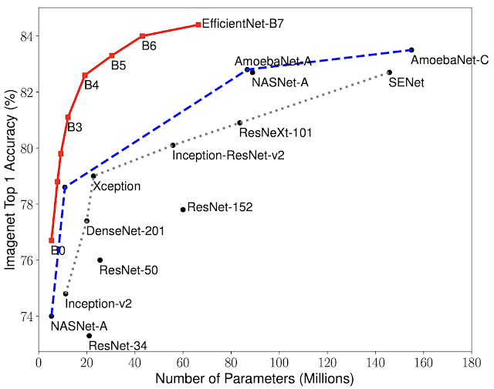
NAS: Neural architecture search
Search space
Performance estimation strategy
Search strategy
Very successful
EfficientNet: Rethinking Model Scaling for Convolutional Neural Networks (Tan et Le., 2019)

Slide 24
Learning: architecture + learning algorithm
Learning algorithm:
A set of functions that specifies how to update the weights.
Also called optimizers
Adam, Momentum, SGD

Slide 25
Learned optimizer
Deep learning
engineering features
learning features
SIFT (Lowe et. al. 1999)
HOG (Dalal et. al. 2005)
LeNet (LeCun et. al. 1998)
AlexNet (Krizhevsky et. al. 2012)
Meta learning
engineering to learn
learning to learn
SGD (Robbins et. al. 1951, Bottou 2010)
Autoencoders (Hinton et. al. 2006)
Learning To Learn (Hochreiter et. al. 2001)
Learned Optimizers (Andrychowicz et. al. dd2016, Li et. al. 2016, Wichrowska et. al. dd2017, Metz et. al. 2018, 2019)
Slide courtesy of Luke Metz

Slide 26
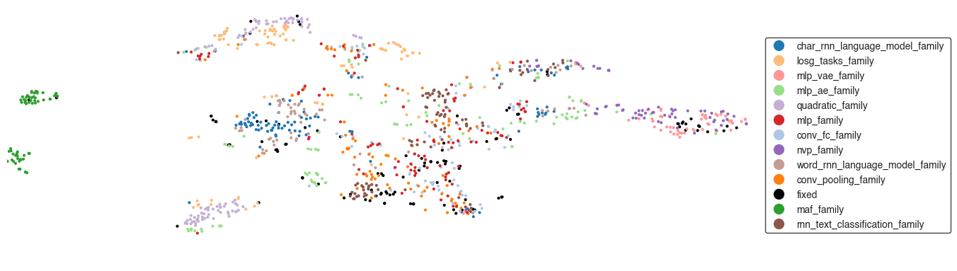
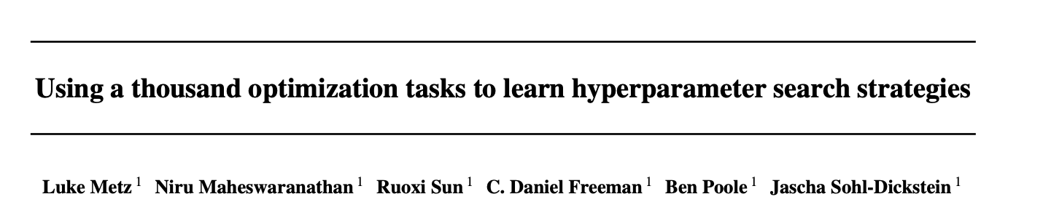
Learned optimizer
Learn how to learn on a set of tasks
Generalize to new tasks
Slide courtesy of Luke Metz

Slide 27
Learned optimizer
Learn how to learn on a set of tasks
Generalize to new tasks
The learned optimizer can then be used to train a better version of itself!
Slide courtesy of Luke Metz

Slide 28
Model calibration
Anastasios Angelopoulos
UC Berkeley

Slide 29
System-level vs. instance-level
System-level metrics: measuring system’s performance on average
Good when we want a lot of approximate predictions
Instance-level metrics: measuring system’s performance on each sample
Required when a single wrong prediction can be catastrophic
Accuracy is not enough when class frequencies are uneven!
What if 80% of patients have class normal and 20% have class cancer? A model could have 80% accuracy by always outputting normal!

Slide 30
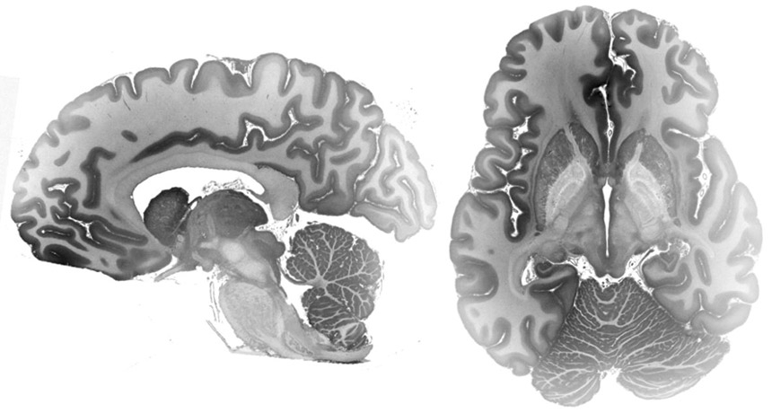
Decision making requires uncertainty
Decision-making algorithms require uncertainty to “rule-in” or “rule-out” risky classes.
The patient may be normal, but if there’s a 5% chance of deadly cancer, the doctor should know.
https://www.biorxiv.org/content/10.1101/649822v2.full.pdf

Slide 31
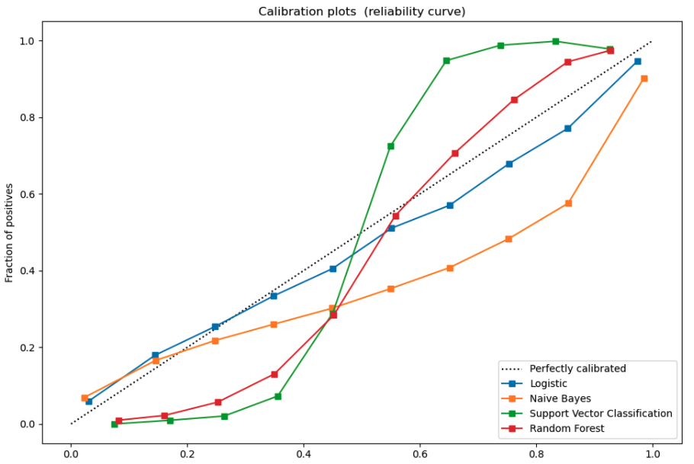
The binary case: calibration
.
If proba for top class is 0.8, then it’s correct 80% of the time
Need to ensure the top class is correct on average
score
Image from Probability calibration (sklearn)

Slide 32
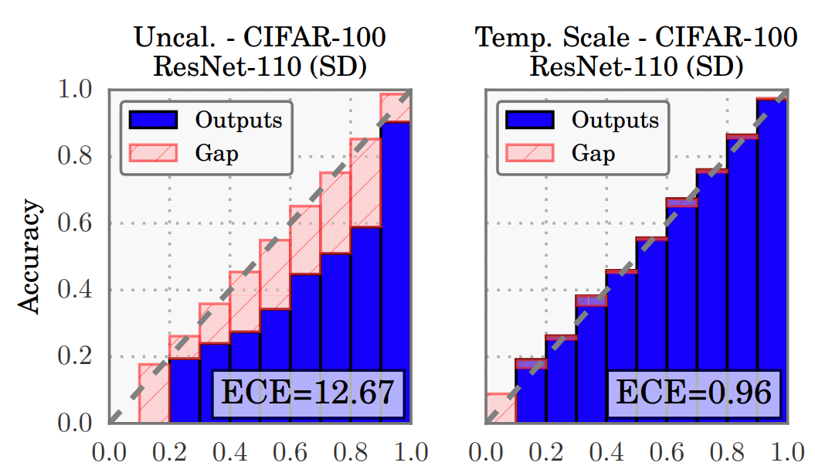

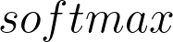
The binary case: calibration
Need to ensure the top class is correct on average.
The score of the top class corresponds to the confidence of your model.
E.g. if the calibrated score < 90%, say “I don’t know!” (We get a guarantee here!)
The most common way is platt scaling/temperature scaling (Guo et al.) .
Model
Top score
Top score
Multiclass problems can be reduced to pseudo-binary by asking, “is my top class correct?”

Slide 33
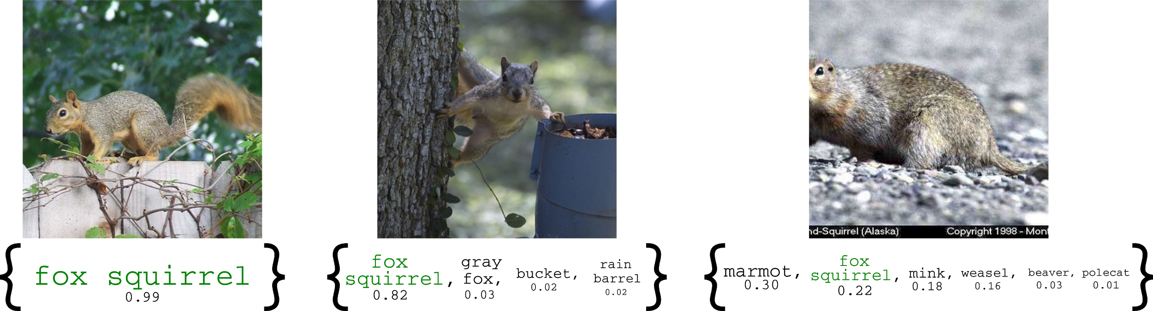
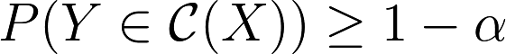
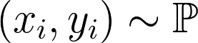
The n-ary case: prediction sets
Rather than predict one output, we predict a set to aid the decision-maker.
These sets should:
Have correct coverage (i.e. contain the correct class with high probability)
Be as small as possible
Be adaptive: the sets should be smaller for ‘easy’ than ‘hard’ examples
We only assume the data are i.i.d. (nothing about the true distribution, algorithm, etc)

Slide 34
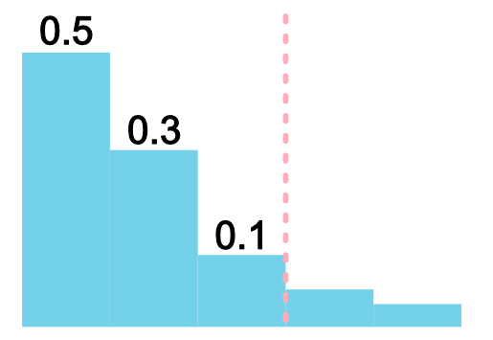
The n-ary case: a naive strategy
Simple strategy: sort classes from highest-to-lowest probability. Stop at 90%.
Problems
Incorrect coverage due to estimation error
Small probability estimates are unreliable -> large & unstable sets

Slide 35
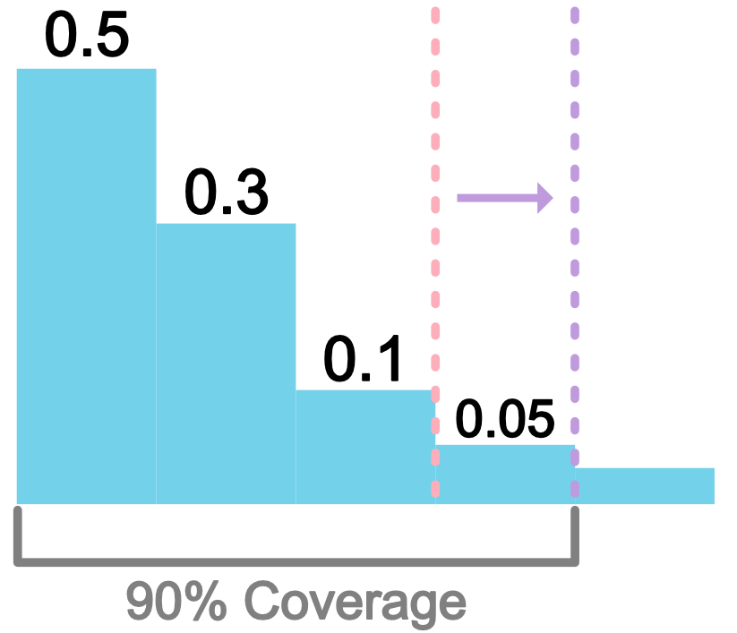
The n-ary case: conformal prediction
Idea: choose threshold based on a holdout set
Benefits:
Exact coverage in finite samples
Sets are adaptive to difficulty of an example
Computationally cheap (with sample splitting)
Angelopoulos, Bates, Malik, and Jordan (arxiv:2009.14193)
Romano, Sesia, and Candes (arXiv:2006.02544)
Vladimir Vovk (Algorithmic Learning in a Random World)
E.g., choose 95% nominal coverage to get 90% coverage on test data

Slide 36
Debugging

Slide 37
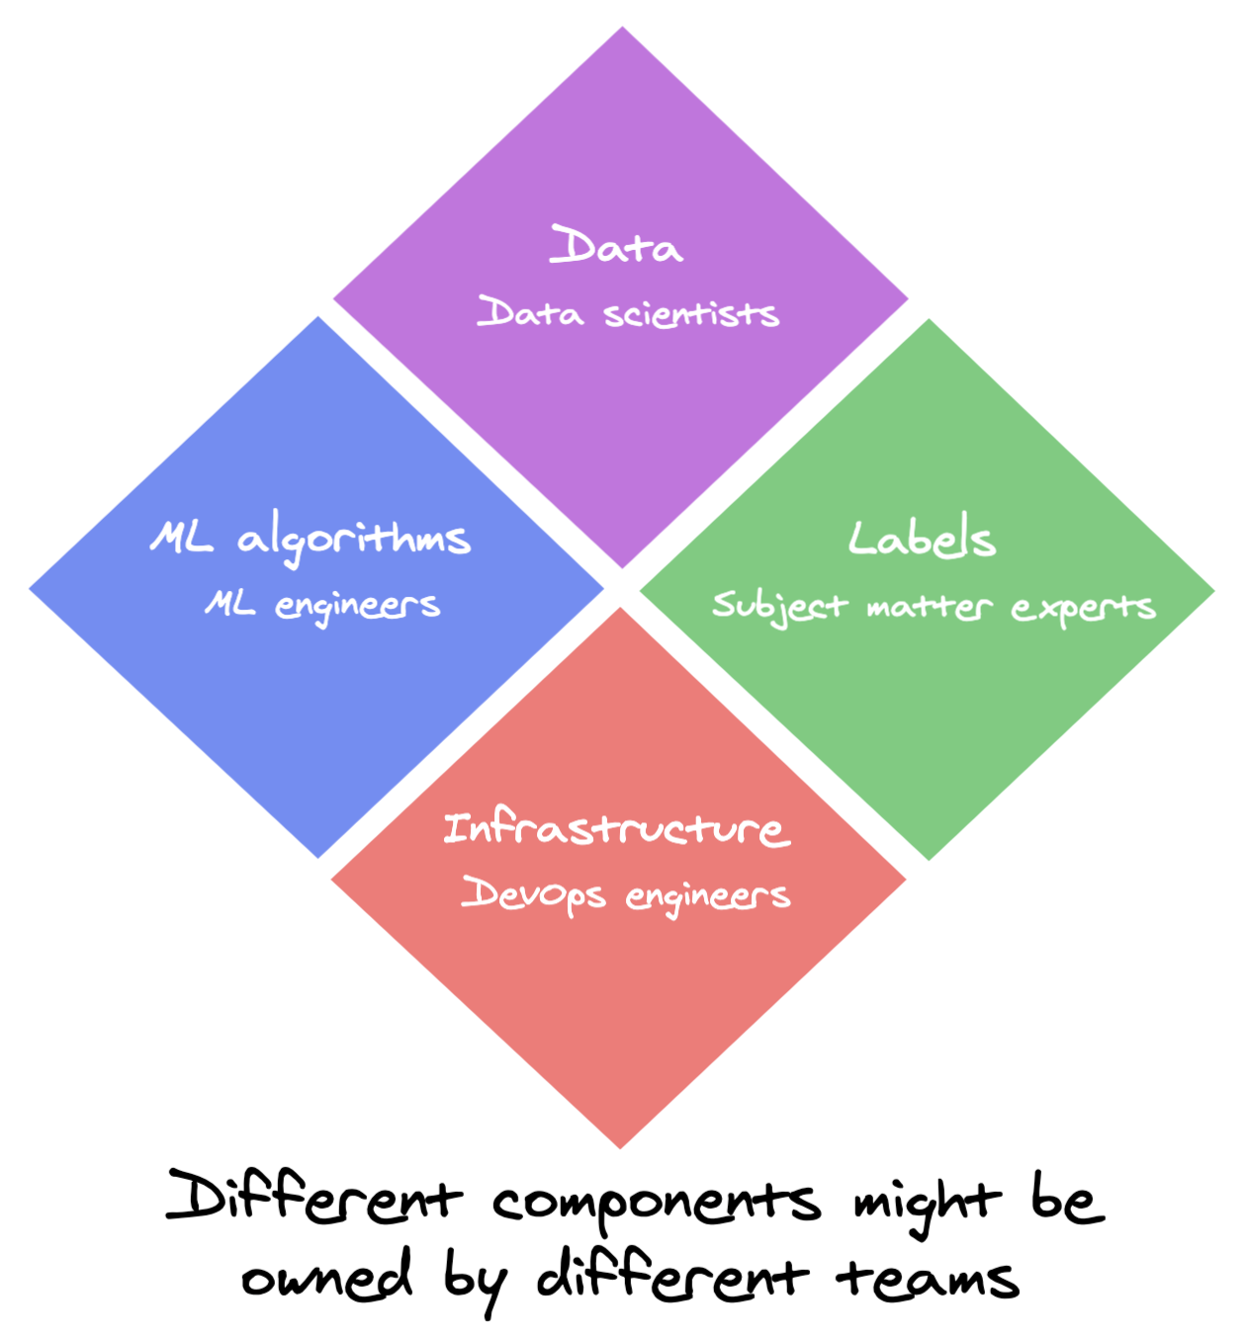
Why is debugging ML systems hard?
Cross-functional complexity
Components owned by different teams
Errors can be because of any or a combination

Slide 38

Why is debugging ML systems hard?
Cross-functional complexity
Silent errors
Developers don’t notice
Users don’t notice

Slide 39

Why is debugging ML systems hard?
Cross-functional complexity
Silent errors
Slow updating cycle
Might have to wait a long time to see whether a bug is fixed
https://xkcd.com/303/

Slide 40
Sources of errors
Theoretical constraints
wrong assumptions, poor model/data fit, problems impossible to solve with ML, etc.
Poor model implementation
layers not connected, call model.train() instead of model.eval()
Poor choice of hyperparameters
Data problems
mismatched inputs/labels, over/under-preprocessed data, noisy labels, bad splits
Feature engineering problems
Features lacking predictive power
Data leakage
Pipeline problems
changes in training pipeline not replicated in inference pipeline
etc.

Slide 41
Breakout exercise (5 minutes, group of 5)
How might you address the following sources of errors?
Poor implementation
layers not connected, call model.train() instead of model.eval()
Poor choice of hyperparameters
Data problems
mismatched inputs/labels, over/under-preprocessed data, noisy labels, bad splits
Feature engineering problems
Features lacking predictive power
Data leakage
Pipeline problems
changes in training pipeline not replicated in inference pipeline

Slide 42
ML system evaluation

Slide 43
ML system evaluation & testing
System
Data testing
Model evaluation
Interface
Pipeline testing
Data
ML algorithms
Infrastructure
System benchmarking
Hardware

Slide 44
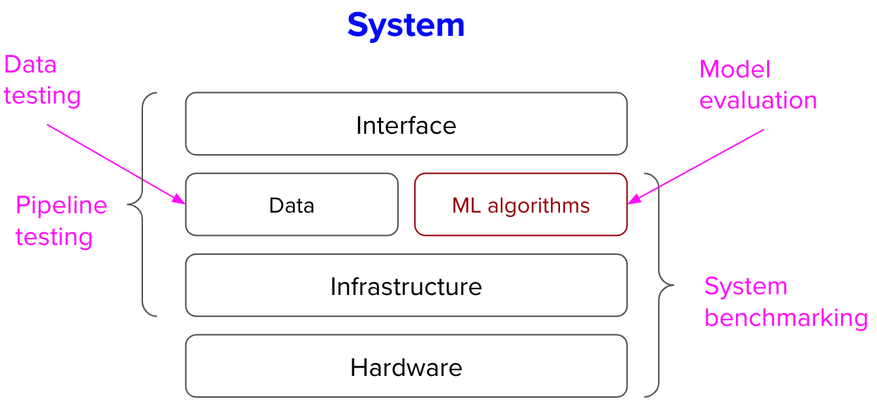
ML system evaluation
Data testing: ensuring new data satisfies your assumptions
NOT covered here: test to see how good a new sample is for your model
Pipeline testing: ensuring your pipeline is set up correctly
〜System benchmarking〜: reporting your system’s overall performance on well-defined tasks, metrics, and rules, usually for the purpose of comparison
Model evaluation: evaluating how good your ML model is

Slide 45
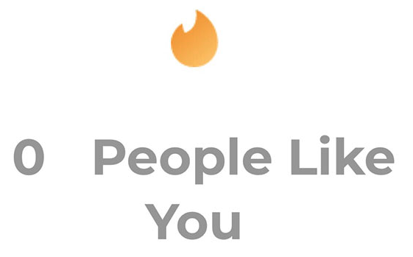
Pipeline testing
Consistency
Does your system make the same prediction on the same input in during training & inference?
Does your system make the same prediction on the same input on different runs?
Integration between components
Can the entire pipeline run end-to-end?
From data loading to feature engineering to training to serving?
[Hard] Visibility
Can you map a sample’s transformation through your entire pipeline?
Edge cases
What happens if inputs violate assumptions?

Slide 46
Tips for ensuring your pipeline correctness
Start simple and gradually add more components
Validate prediction assumption
Validate pipeline
Understand the impact of each added component
Overfit a single batch
If a model can’t memorize a small amount of data perfectly, something is wrong
Make sure an input has same output in both training and inference
Write an end-to-end test
Set random seeds
For reproducibility
Change random seeds
The more sensitive your model is to inconsequential things, the harder it’ll be retrain/maintain it

Slide 47
Data testing: label quality & correlation
Manually check quality of your labels
If labels come from multiple sources, check correlation/conflicts among them

Slide 48
Data testing: feature engineering
Do features make sense?
When new features are added, are old features still necessary?
Are missing values replaced with mean/default values?
Sanity-check after each transformation
...

Slide 49


Data testing: assumptions
Models embed assumptions about data
Both inputs and outputs
Example assumptions:
geotags are available -> model performs weird when geotags are null
answers’ lengths are within 1 minute
How to know if these assumptions hold in production?

Slide 50
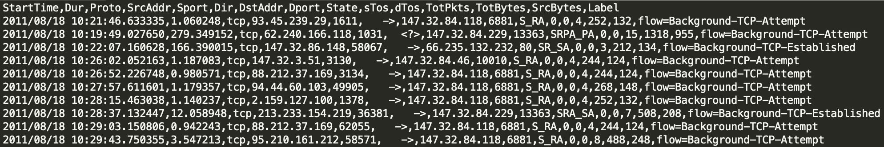
Data testing: assumptions
Pre-train
Data exploration
Some data might make no sense to non-experts
Data profiling & visualization
Create assertions
Post-train
Make sure each new data sample passes assertions

Slide 51
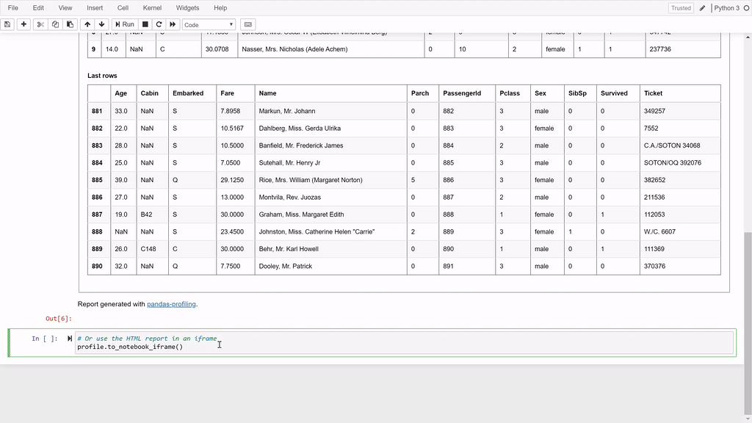
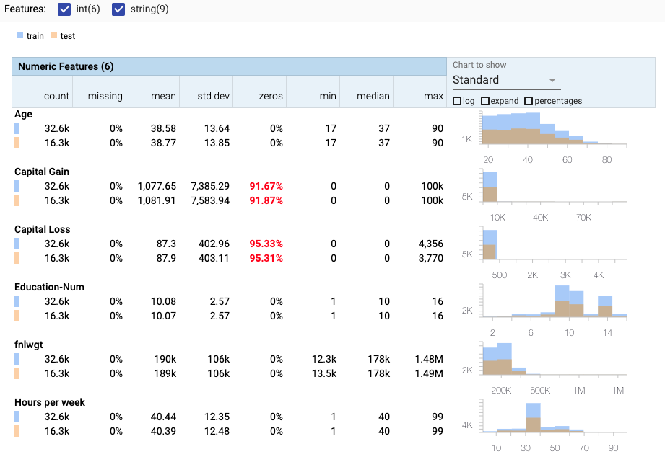
Data profiling & visualization
Examining data & collecting:
statistics
informative summaries
pandas-profiling
facets

Slide 52
Data assertions
Common sense assertions
“the” is most common word in English
Categorical data belongs to a predefined set
Continuous data is within a range
Outputs should follow a distribution
Inputs should follow a distribution

Slide 53
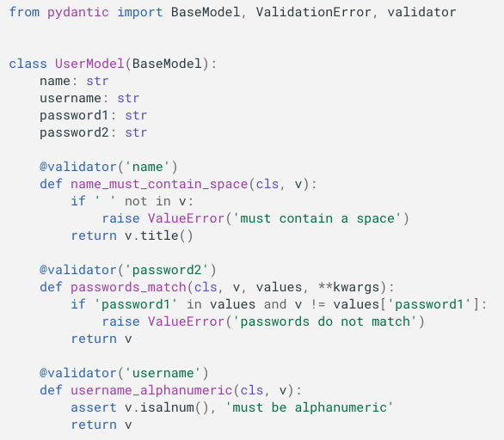
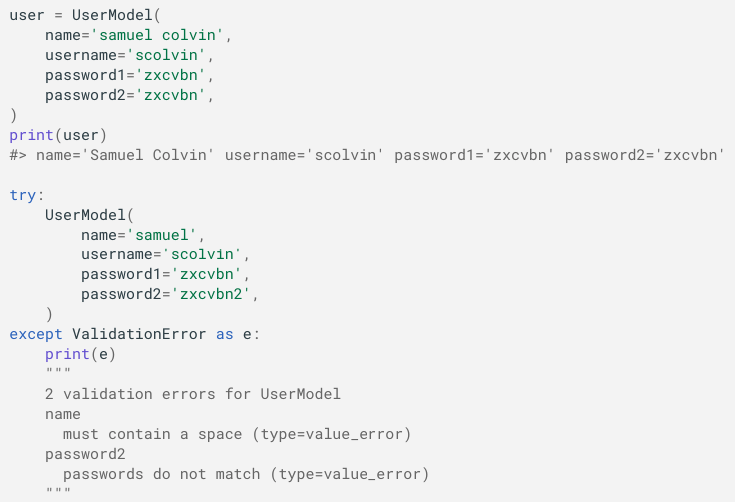
Data testing: specifying schema in your code
https://pydantic-docs.helpmanual.io/usage/validators/

Slide 54
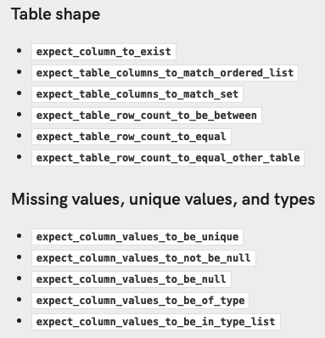
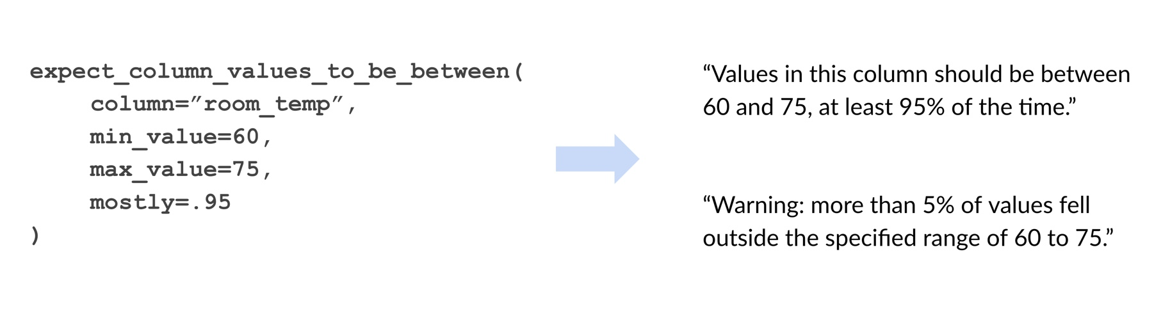
Data testing: creating data schema
https://github.com/great-expectations/great_expectations

Slide 55
Benchmarking
Reproducible experiments with well-defined tasks, metrics, and rules
Guide development
E.g. shared tasks on machine translation from 2006
Measure progress
E.g. benchmark datasets/tasks for research
Customers might require it (possibly to compare with other solutions)
E.g. latency, memory usage, prediction cost, accuracy of your model on their provided data
Compete with other systems
E.g. MLPerf
⚠ Designing benchmarks can be very, very difficult ⚠

Slide 56
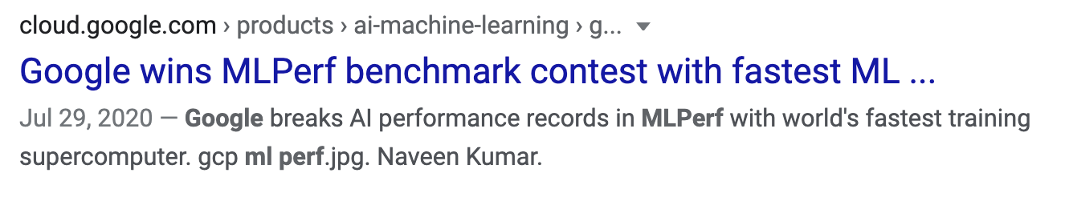
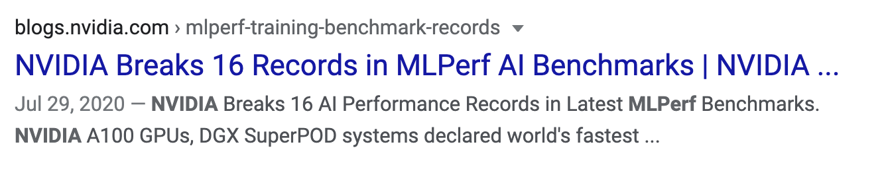
One benchmark, two headlines

Slide 57
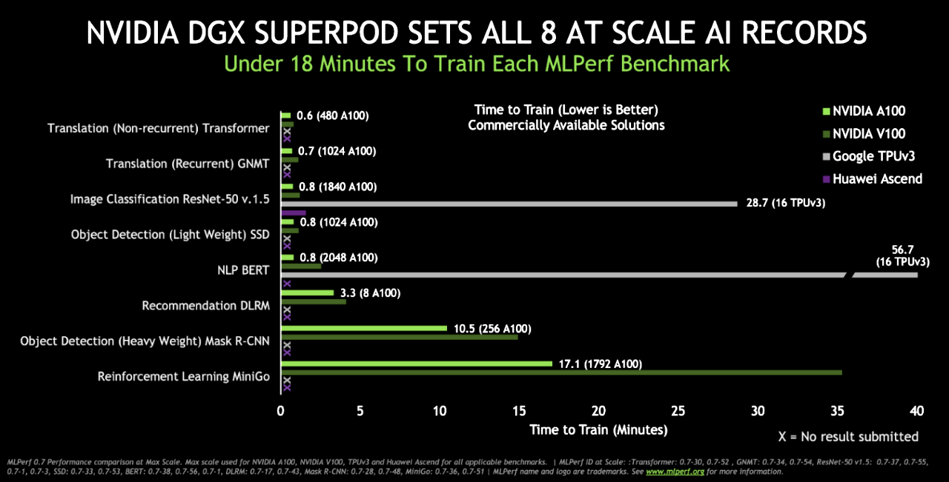
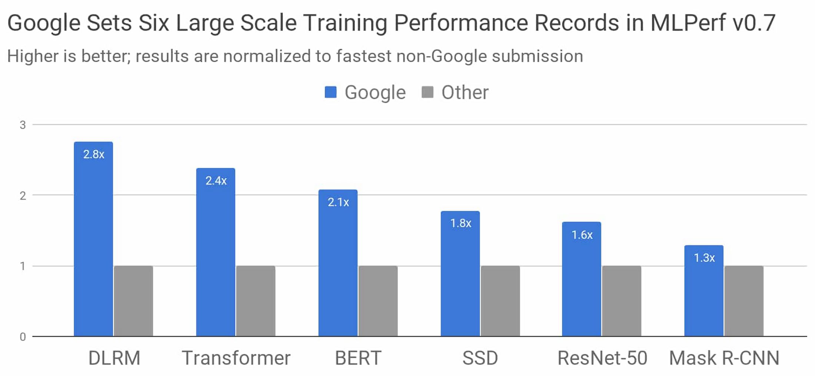
One benchmark, two results

Slide 58
Model evaluation

Slide 59
Model evaluation
(Evaluating against baselines already covered in a previous lecture)
Slice-based evaluation
Perturbation evaluation
Invariance tests
Directional expectation tests
Ablation study

Slide 60
Slice-based evaluation

Slide 61
Models perform differently on different slices
Classes
Might perform worse on minority classes
Subgroups
Gender
Location
Time of using the app
etc.

Slide 62
Models perform the same on different slices with different cost
User churn prediction
Paying users are more critical
Predicting adverse drug reactions
Patients with underlying conditions are more critical
⚠ Focusing on improving only overall metrics might hurt performance on subgroups ⚠

Slide 63

Simpson’s paradox
Models A and B to predict whether a customer will buy your product
A performs better than B overall
B performs better than A on both female & male customers

Slide 64
Simpson’s paradox
 | Treatment 1 | Treatment 2
Group A | 93% (81/87) | 87% (234/270)
Group B | 73% (192/263) | 69% (55/80)
Overall | 78% (273/350) | 83% (289/350)
Numbers from a kidney stone treatment study. (Charig et al., 1986)

Slide 65
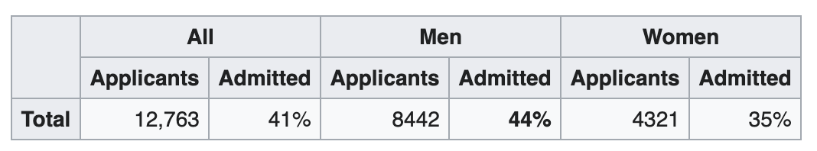
Simpson’s paradox: Berkeley graduate admission ‘73
Bias against women in the process, or is there?
Sex Bias in Graduate Admissions: Data from Berkeley (Bickel et al., 1975)

Slide 66
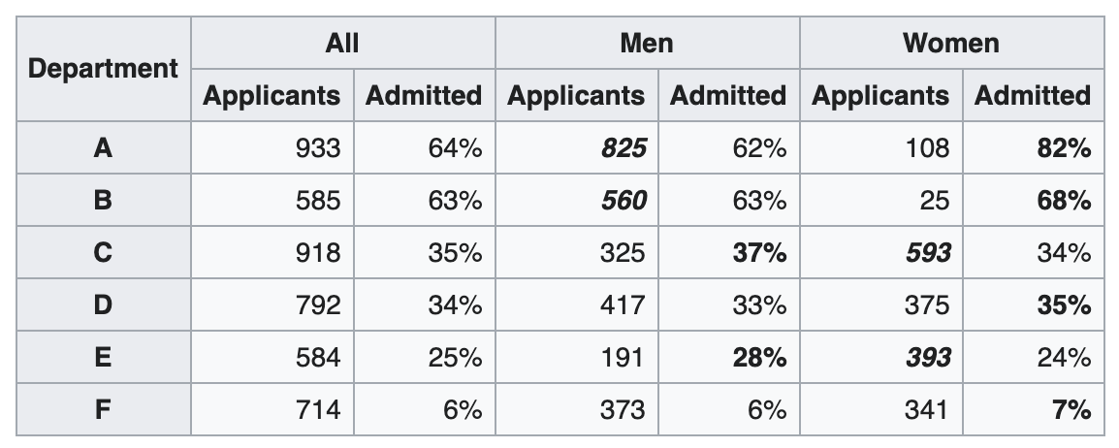
Simpson’s paradox: Berkeley graduate admission ‘73
⚠ Aggregation can conceal and contradict actual situation ⚠
Sex Bias in Graduate Admissions: Data from Berkeley (Bickel et al., 1975)

Slide 67
Slice-based evaluation
Evaluate your model on different slices
E.g. when working with website traffic data, slice data among:
gender
mobile vs. desktop
browser
location
Check for consistency over time
E.g. evaluate your model on data slices from each day

Slide 68
Slice-based evaluation
Improve model’s performance both overall and on critical data
Help avoid biases
Even when you don’t think slices matter, slicing can:
give you confidence on your model (to convince your boss)
might reveal non-ML problems

Slide 69
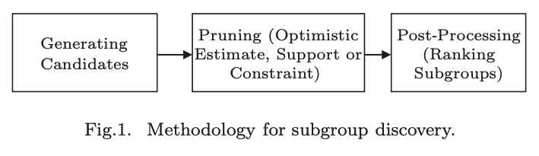
How to identify slices?
Heuristics
Might require subject matter expertise
Error analysis
Patterns among misclassified samples
Slice finder
Exhaustive/beam search
Clustering
Decision tree
Slice finder: Automated data slicing for model validation (Chung et al., 2019) Subgroup Discovery Algorithms: A Survey and Empirical Evaluation (Sumyea Helal, 2016)

Slide 70
How to identify slices?
⚠ Still more of an art than a science ⚠
Heuristics
Might require subject matter expertise
Error analysis
Patterns among misclassified samples
Slice finder
Exhaustive/beam search
Clustering
Decision tree
Slice finder: Automated data slicing for model validation (Chung et al., 2019) Subgroup Discovery Algorithms: A Survey and Empirical Evaluation (Sumyea Helal, 2016)

Slide 71
Perturbation evaluation

Slide 72
Perturbation evaluation
Randomly add small noise to data to see how much outputs change
User inputs might contain noise
Speech recognition: background noise
Object detection: different lighting
Text inputs: typos, intentional changes (e.g. looooooooong)
Do small changes in inputs lead to big changes in outputs?

Slide 73
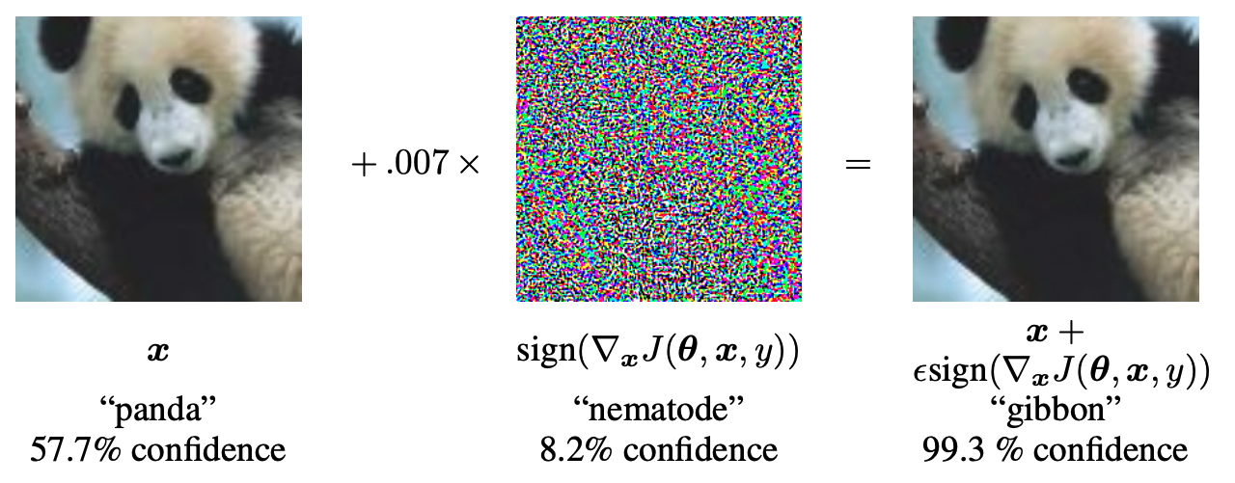
Perturbation evaluation
Randomly add noise to data to see how much outputs change
The more sensitive the model is to noise:
The harder it is to maintain
The more vulnerable the model is to adversarial attacks
EXPLAINING AND HARNESSING ADVERSARIAL EXAMPLES (Goodfellow et al., 2015)

Slide 74
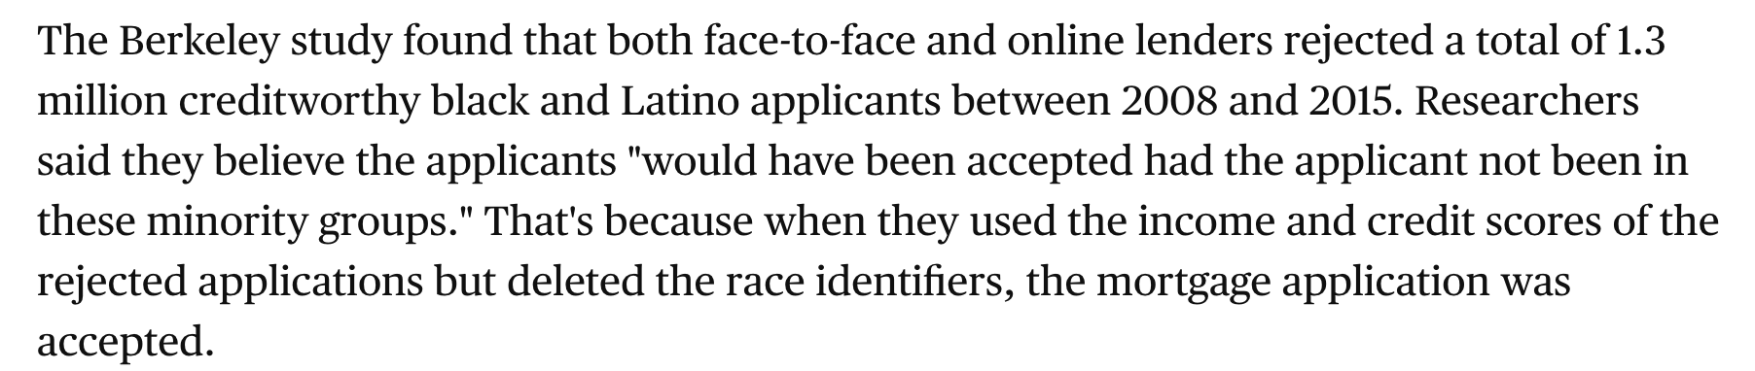
Invariance tests
Some input changes shouldn’t lead to changes in outputs
Changing race/gender info shouldn’t change predicted approval outcome
Changing name shouldn’t affect resume screening results
Disparity in home lending costs minorities millions, researchers find (CBS News, 2019)

Slide 75
Directional expectation tests
Some changes to inputs should cause predictable changes in outputs
E.g. when predicting housing prices:
Increasing lot size shouldn’t decrease the predicted price
Decreasing square footage shouldn’t increase the predicted price

Slide 76
Ablation study
Systematically removing parts of your model to see which ones are relevant to the model’s performance
Features
Model components: e.g. regularizations

Slide 77
⚠ Short-term results ≠ long-term results ⚠
Identical results short-term don’t mean identical results long-term
Superior models now don’t mean superior models a week from now on

Slide 78










Ishan got a head scratcher!
9 6 3 2 7
5 1 8 10 4

Slide 79
Machine Learning Systems Design
Next class: Versioning and experiment tracking
cs329s.stanford.edu | Chip Huyen

